Slide 1
A Brief History of Cryptography
Kevin Jones

Slide 2
Who Am I
Application Developer
Cryptography Developer
Mostly .NET and Windows
By Night Network IT

Slide 3
Contact
https://github.com/vcsjones/Presentations/
@vcsjones

Slide 4
What are we talking about?
A means of obfuscating information such that only someone holding a related piece of information can decipher it.

Slide 5
Timeline
1500 BCE
718
1932
2016
Mesopotamia Cuneiform
tablets.
Al-Kindi is born, wrote first known book on cryptology.
First appearance of the enigma machine.
Today
The Caesar Cipher.
Frank Miller describes the One Time Pad.
Public key cryptography appears
40 BCE
1882
1975 ‘76

Slide 6
Substitution
ABCDEFGHIJK
FEDGKCBIKAH

Slide 7
Timeline
1500 BCE
718
1932
2016
Mesopotamia Cuneiform
tablets.
Al-Kindi is born, wrote first known book on cryptology.
First appearance of the enigma machine.
Today
The Caesar Cipher.
Frank Miller describes the One Time Pad.
Public key cryptography appears
40 BCE
1882
1975 ‘76

Slide 8
Timeline
1932
1993
2016
First appearance of the enigma machine.
Clipper Chip
introduced
Today
Frank Miller describes the One Time Pad.
Crypto export laws appear
Public key cryptography appears DES appears
BIS takes
control of export
1882
1950’s
1975 ‘76
2009

Slide 9
One Time Pad
HELLO
07 04 11 11 14
The message
+
23 20 02 25 00
⩭
XUCZA
The key
⩭
26 26 26 26 26
04 24 13 10 14
E Y N K O
Cipher text

Slide 10
Key Transport
Encryption had strong math backing it up
Inability to distribute keys effectively made it hard
Inability to reuse keys made it impossible

Slide 11
The DES of 1975
48-bit too weak - 15 digit numbers
64-bit too strong - 20 digit numbers
…

Slide 12
Let’s Do Math! (Really)
p = 2213
g = 492
https://vcsjones.com/modpow
gª % p = A
g^{b} % p = B
S1 = Bª % p
S2 = A^{b} % p

Slide 13
Timeline
1993
2016
Clipper Chip
introduced
Today
BIS takes
control of export
2009

Slide 14
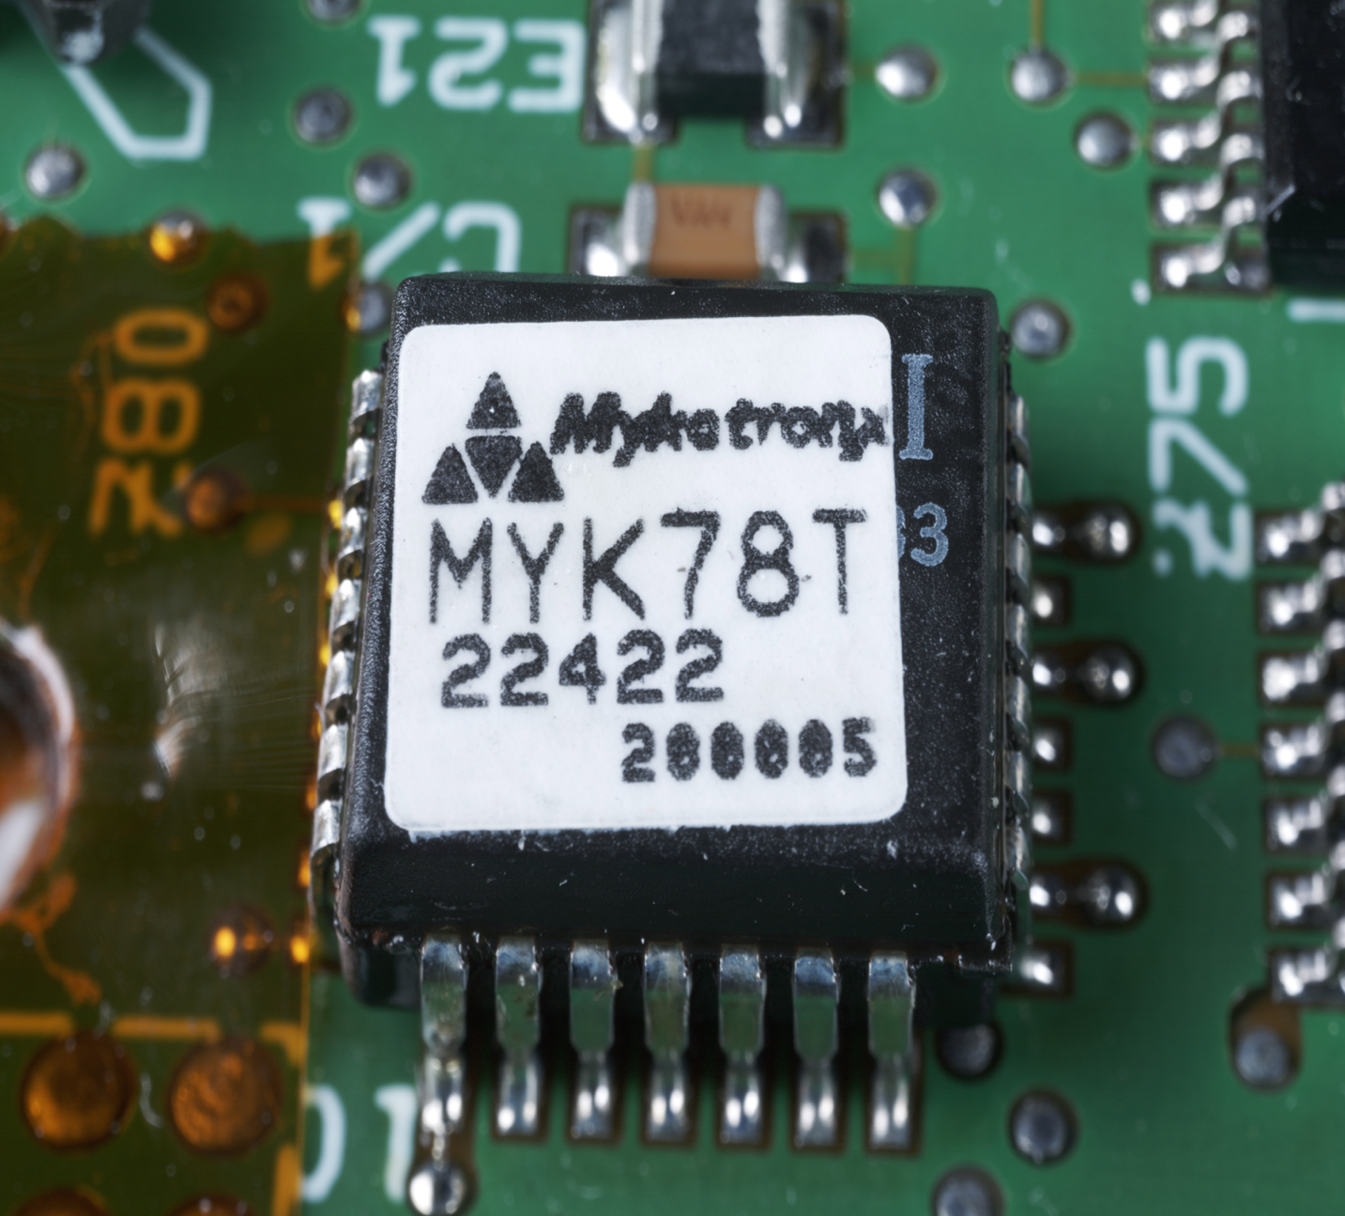
Clipper Chip
Skipjack
Key Escrow
Deeply flawed
Matt Blaze, Flickr

Slide 15
The 1990’s
Clinton moved crypto from DOD to DOC
Export restrictions eased

Slide 16
The 2000s
DES replaced with AES
Export controls still have lasting effects to 2016
Cryptography appears in mainstream consumer products
US and Foreign governments need access

Slide 17
Tomorrow?
Crypto debate will never go away

Slide 18
Questions?

